Slide 1
Welcome to the world of Cambrian Multimedia presentation.

Slide 2
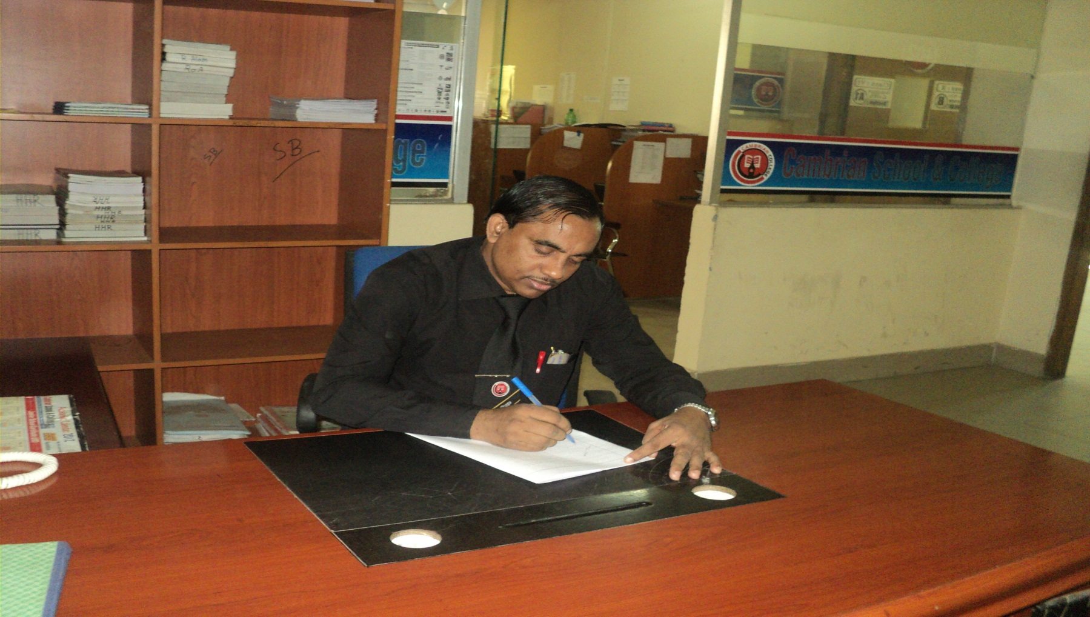
Md Hasan Hafizur Rahman
Senior Lecturer
Department of English
Cambrian School & College,Dhaka,
Class-Eight
English 1st Paper

Slide 3
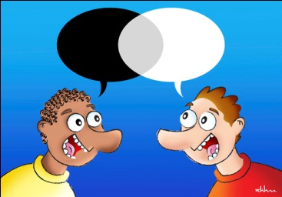
Dialogue

Slide 4
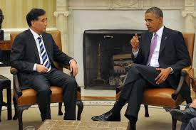
Dialogue

Slide 5
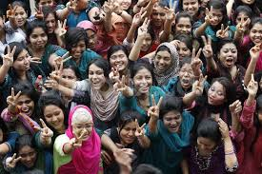
Brilliant Result

Slide 6
Our Today’s Lesson is-
A dialogue on
“A Brilliant Result”

Slide 7
Learning outcomes
After we have studied this lesson we will be able to-
exchange greetings
ask and answer questions
achieve inspiration
write a dialogue.

Slide 8
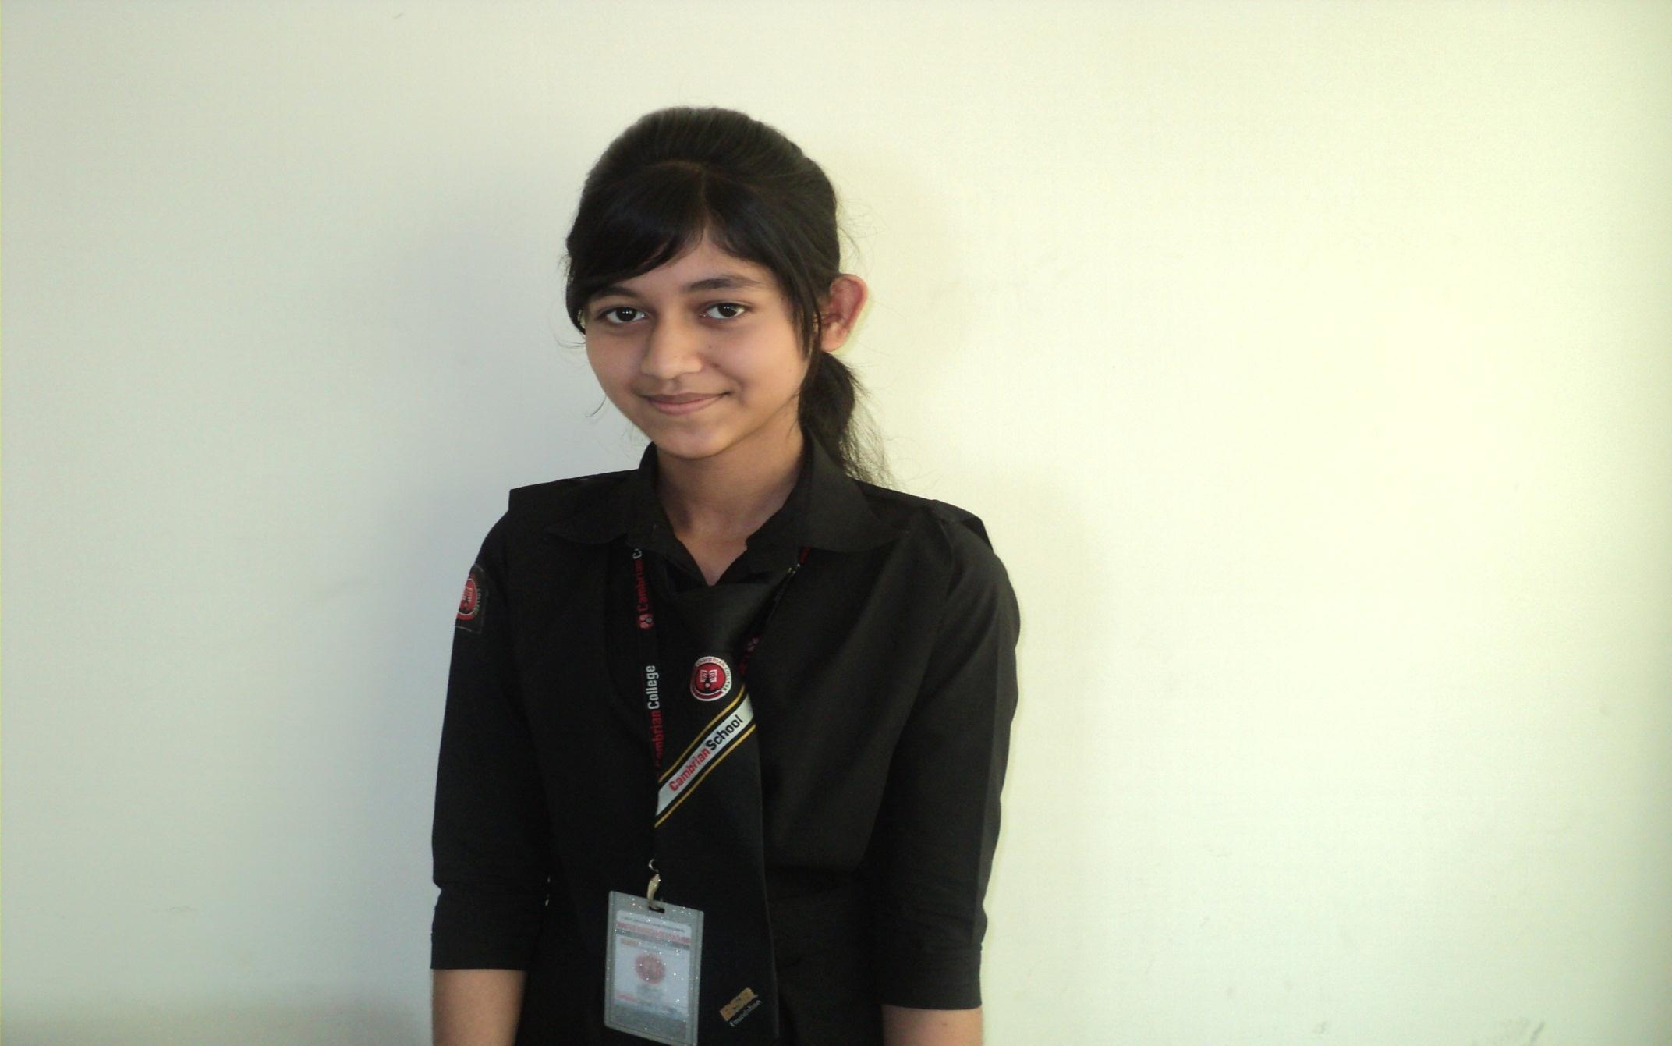
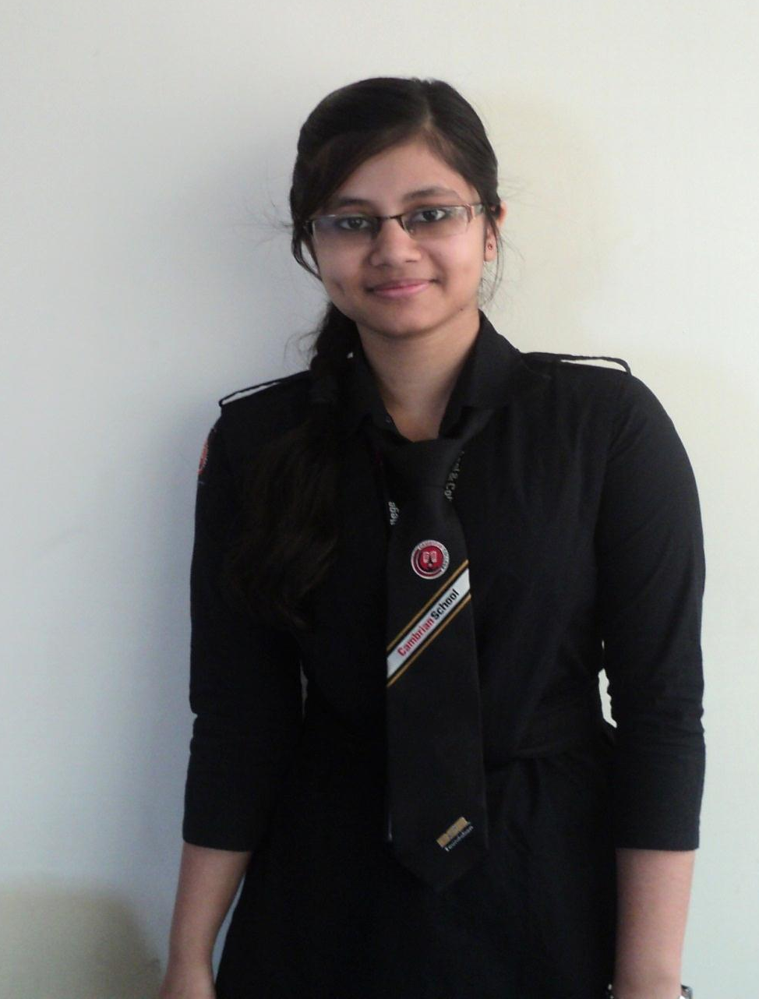
Ayesha
Mumu
Ayesha and Mumu are friends.

Slide 9
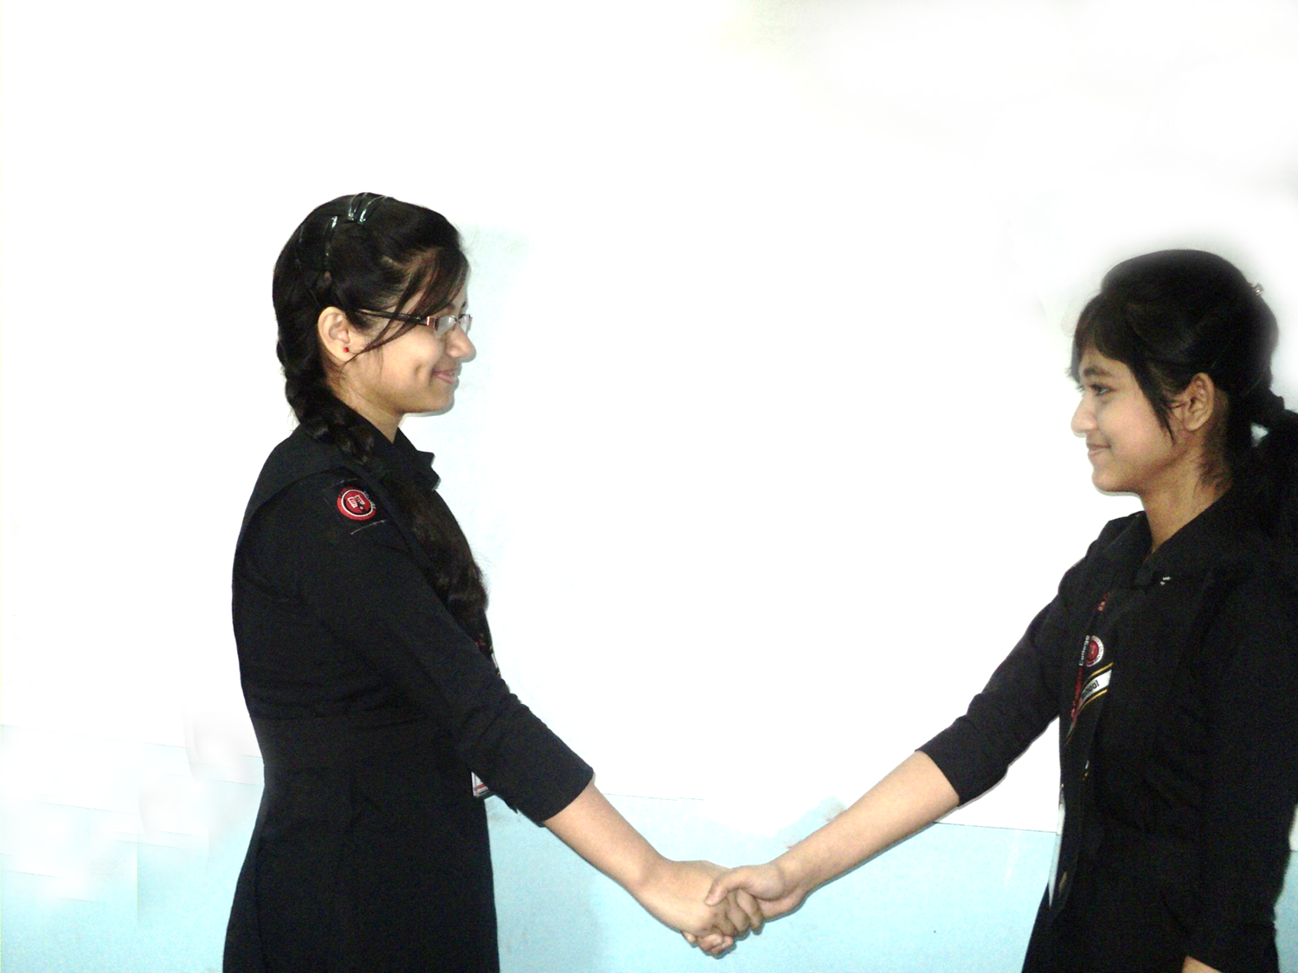

Hi friend, How are you?
I am fine and you?

Slide 10
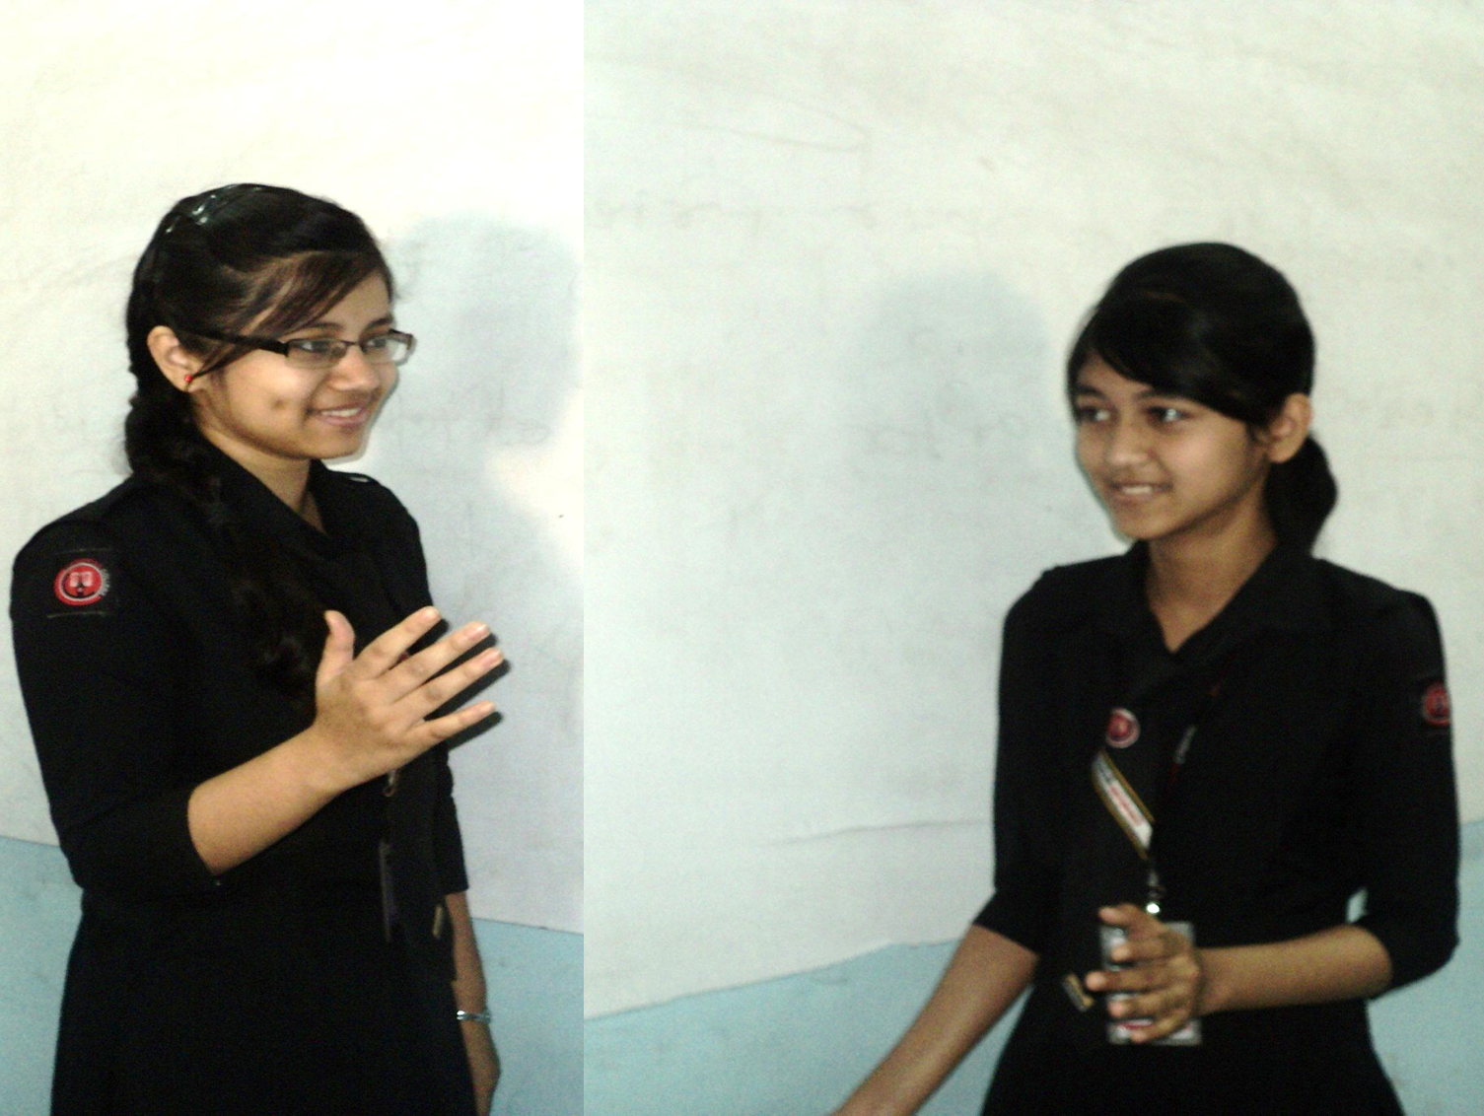
I am well and very excited.
But why?

Slide 11
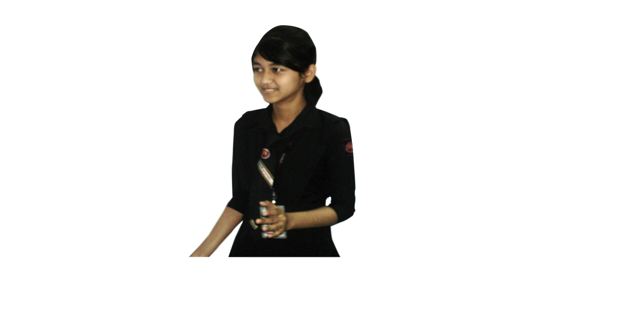
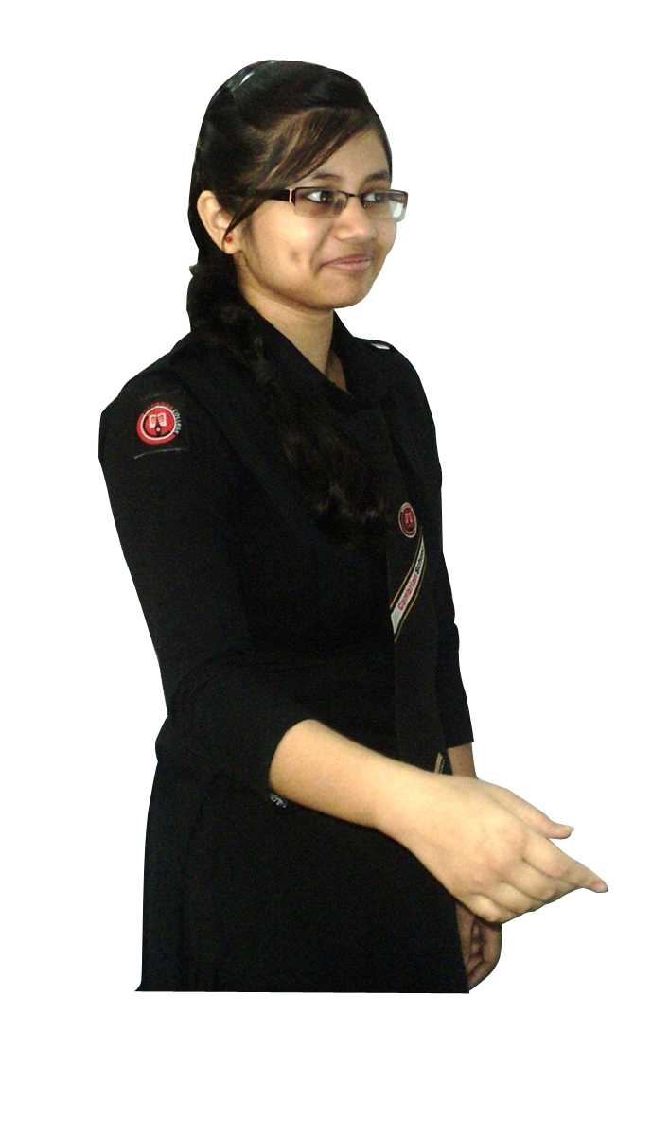
Don’t you know the result of my JSC exam?
Actually I don’t know. Please tell me.

Slide 12
I have got golden A+.
Oh! Really?

Slide 13
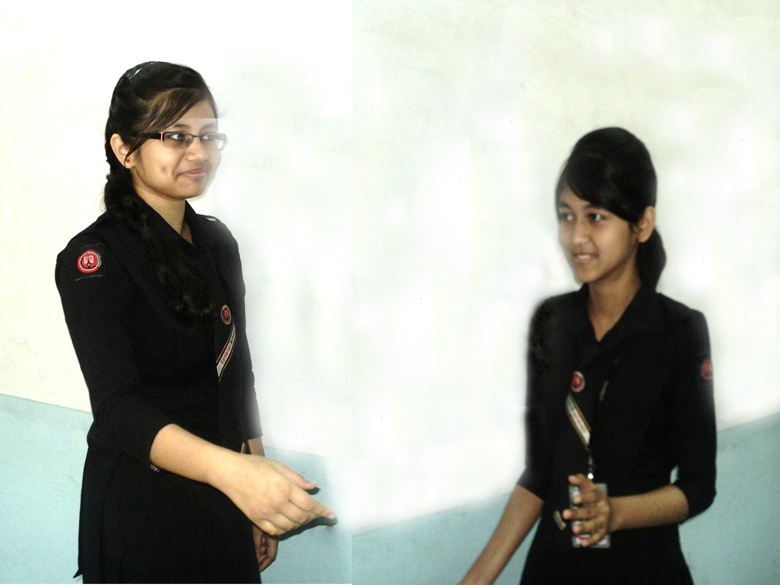
Yes.
Congratulation!
How have you achieved such a brilliant result?

Slide 14
It was for hard study and perseverance.
Will you tell me about perseverance?

Slide 15
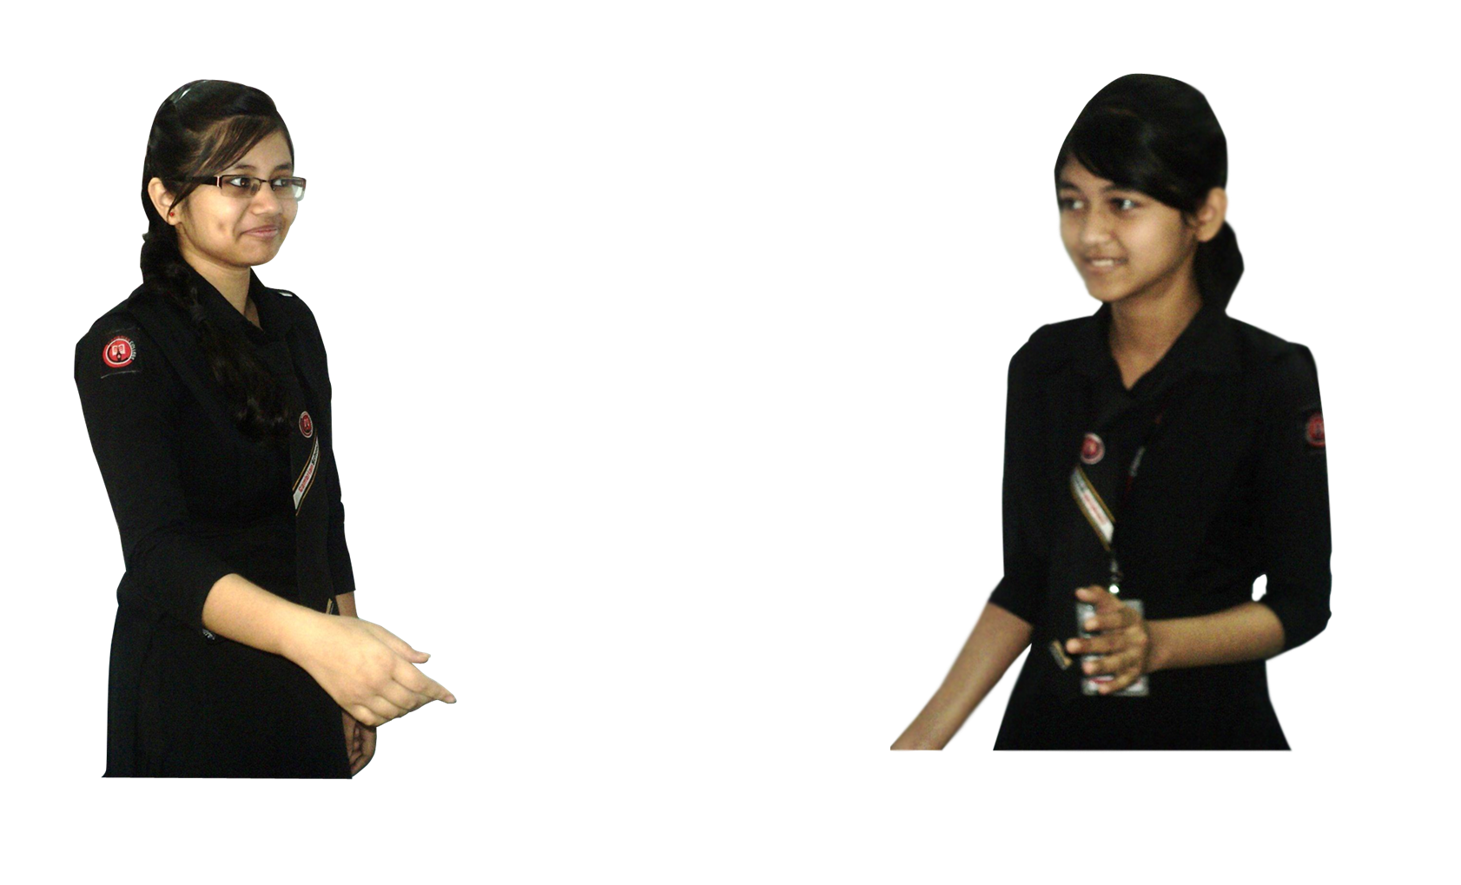
Why not?
Please explain.

Slide 16
Perseverance means study with determination.
I am not clear.
Please explain more.

Slide 17
I mean study to achieve a target and it is a brilliant result.
But is it enough for making such a brilliant result?

Slide 18
O, “No” There are something more behind it.
What are they?

Slide 19
Help of the teachers, proper guidance of the parents and above all determination.
You are really a genius.

Slide 20
As you say.
Will you help me please?

Slide 21
Of course. What kind of help?.
I hope your suggestions.

Slide 22
You have to read all the texts time and again.
Why do I need to read text, isn’t guide enough?

Slide 23
O, no. It will help you to cover full marks in objective portion.
Ok, very good suggestion. Then what?

Slide 24
You have to prepare notes on individual subjects and it should be amended by the subject teachers.
Anything more than this?

Slide 25
Punctuality and instructions of the teachers are also very essential for a brilliant result.
I am really grateful to you for your effective suggestions.

Slide 26
Thank you my friend.
You are most welcome.

Slide 27
Hi friend, How are you?
I am fine and you?
I am well and very excited.
But why?
Don’t you know the result of my JSC exam?
Actually I don’t know. Please tell me
I have got golden A+.
Oh! Really?
Yes.
Congratulation! How have you achieved such a brilliant result?
It was for hard study and perseverance.
Will you tell me about perseverance?
Why not?
Please explain
Perseverance means study with determination.
I am not clear. Please explain more.

Slide 28
I mean study to achieve a target and it is a brilliant result.
But is it enough for making such a brilliant result?
O, “No” There are something more behind it.
What are they?
Help of the teachers, proper guidance of the parents and above all determination.
You are really a genius.
As you say
Will you help me please?
Of course. What kind of help?.
I hope your suggestions.
You have to read all the texts time and again.
Why do I need to read text, isn’t guide enough?
O, no. It will help you to cover full marks in objective portion.
Ok, very good suggestion. Then what?
You have to prepare notes on individual subjects and it should be amended by the subject teachers.
Anything more than this?

Slide 29
Punctuality and instructions of the teachers are also very essential for a brilliant result.
I am really grateful to you for your effective suggestions.
Thank you my friend.
You are most welcome.

Slide 30
Pair Work
Every single pair is suggested
to write a dialogue on,
“ A Brilliant Result.”

Slide 31
Evaluation
Answer the following questions-
What is a brilliant result?
What should you do to make a brilliant result?
Why do you need to make a planned routine?
How can you cover full marks in objective questions?
Why is it necessary to make a brilliant result?

Slide 32
Homework
Make a dialogue with your friend about a
“Brilliant Result”

Slide 33
Verse Universal
“Brilliant result,
golden future”

Slide 34
Bye bye
Good bye

